Slide 1
Multidimensional Scaling & Cluster Analysis
STAT 3611
Zeyun Lin & Hong Liu
4/16/2013

Slide 2
Data Explanation
The data we selected is from “2012 County Health Ranking Minnesota Data”
We carried out both Multidimensional Scaling (Classical) and Cluster Analysis (Agglomerative Hierarchical Clustering---Complete Linkage method)
There are 6 variables (“Mortality”, “Morbidity”, “Health Behaviors”, “Clinical Care”, “Social Economic” and “Physical Environment”) and 84 counties in the data, but both MDS and Cluster Analysis are shown the relationship among these 84 cases, not the 6 variables.

Slide 3
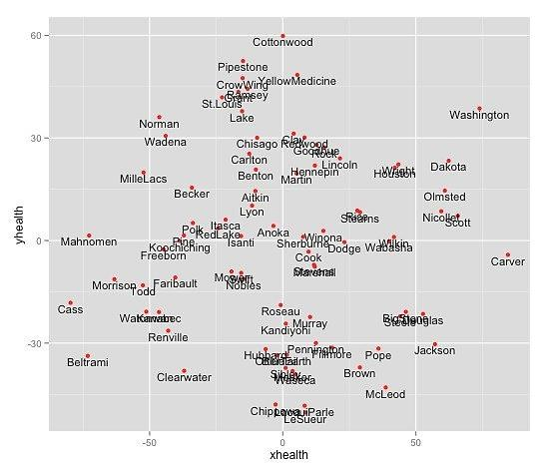
Method 1: Multidimensional Scaling
Cook
Steven

Slide 4
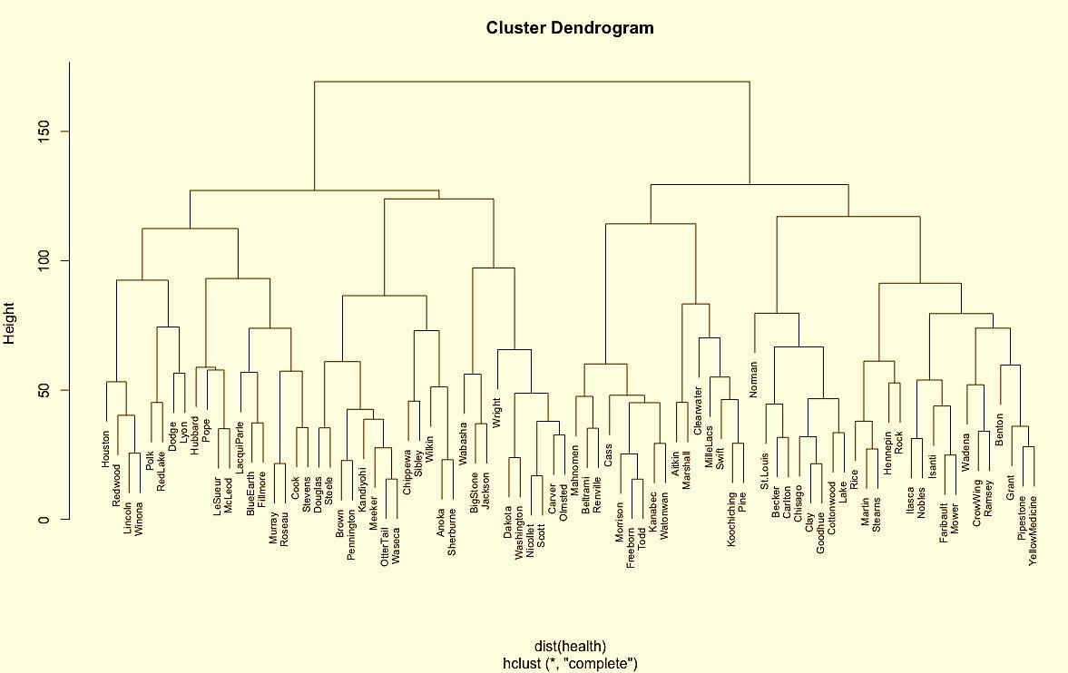
Method 2: Cluster Analysis

Slide 5
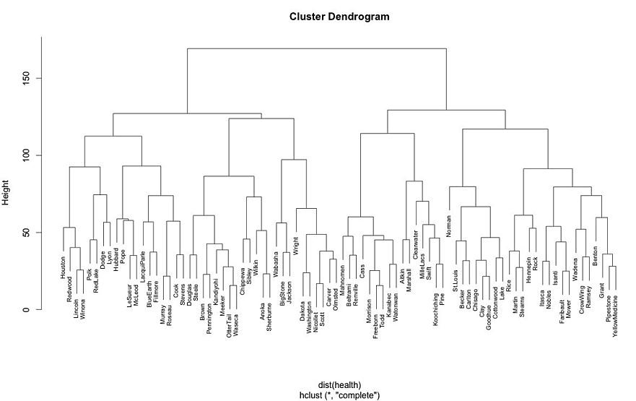
Combine MDS & Cluster analysis
A
C
B
D
C
B
A
D

Slide 6
Interpretation
Combine MDS with Cluster Analysis
In MDS, Steven and Cook are close to each other, which means they behave similarly
In Cluster Analysis, we observed the same pattern
The other two clusters highlighted in both graphs are illustrated the same clustering pattern
Reason of chosen Complete linkage method
Complete linkage tends to find compact clusters of approximately equal diameters.
Complete method avoids a drawback of single linkage which is chaining phenomenon, where clusters formed via single method may be forced together due to single elements being close to each other

Slide 7
Questions or Comments ?
Thank you for your time!!

